Slide 1

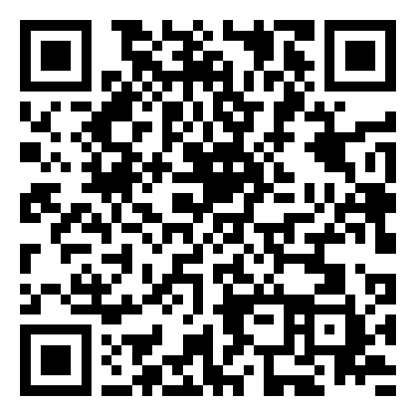
Smart Slides
Make Slides in a flash
How to use Smart Slides

Slide 2
Evaluating ChatGPT as a Recommendation System: A Comprehensive Study
Presented by: First Author
Contact: peyman.75.naseri@gmail.com

Slide 3
Introduction
Exploration of ChatGPT's potential in recommendation systems.
Significance in NLP and digital user experience enhancement.

Slide 4
Problem Statement
Need for flexible, generalized recommendation systems.
ChatGPT's role in addressing evolving user demands.

Slide 5
Objectives and Achievements
Goals vs. accomplishments.
Adjustments made due to constraints.

Slide 6
Related Work
Foundation models: BERT, GPT.
Divergence and contributions of this project.

Slide 7
Dataset Overview
Amazon Beauty dataset.
Relevance and challenges.

Slide 8
Methodology
Using ChatGPT and LLAMA for recommendations.
Challenges: computational costs, hardware limitations.

Slide 9
Results and Analysis
Comparison with traditional methods.
Insights from ChatGPT's performance.

Slide 10
Conclusion
Summary of findings.
Future research directions.

Slide 11
Q&A
Feel free to ask any questions.

Slide 12
Thanks for using Smart Slides
Learn more about how to use this plugin by visiting https://smartslides.crisp.help/en/article/how-to-use-smart-slides-1w14fiw/
Example Prompts:
Make me a 5 slide presentation about the history of the united states and include charts with images of mountains and rivers
Make me a 5 slide tourist presentation about Norway and lofoten islands with varied layouts and images of the northern lights using
Create a presentation with 5 slides about Sydney with images of Bondi Beach and the Opera House use font size 46 for headings and 36 for content. Use this color #FF5A5F (red) and inlude lots of image slides

